Slide 1




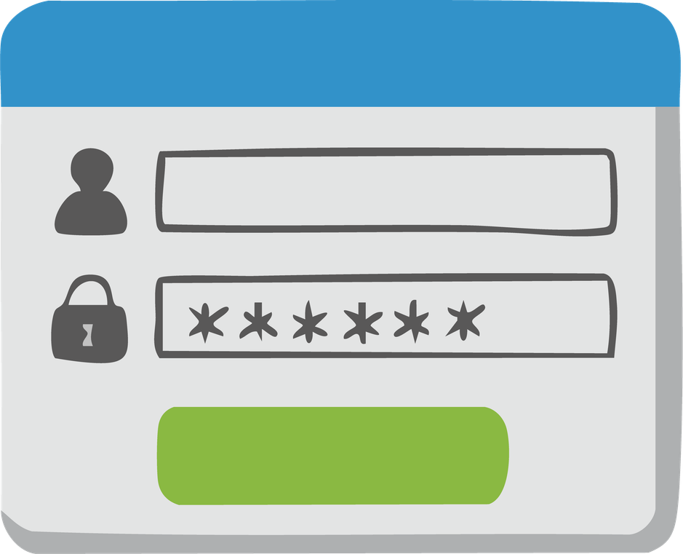





Phishing Awareness Training
Prepared by: Buthaina AL-Riyami

Slide 2
What is Phishing?
Phishing is a type of cyberattack that uses deceptive messages, websites, or other communication methods to trick people into revealing sensitive information or performing an unsafe action.

Slide 3


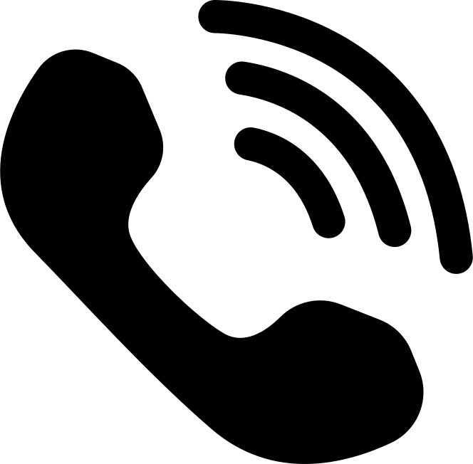




What is Phishing?
  Usernames and passwords
  Banking and payment information
  Personal information
  One-Time Passwords (OTPs)
  Company credentials
  Sensitive files or data
Can happen through:
Email
Attackers may try to steal:
SMS
phone calls
Fake Website
Common goal: Make the victim trust the attacker and take an action that benefits the attacker.

Slide 4




Email Phishing
Fake emails designed to trick users into clicking links, opening attachments, or providing information.
Vishing
Phishing performed through voice calls or VoIP.
Common Types
of Phishing
Smishing
Phishing attacks delivered through SMS or text messages.
Spear Phishing
A targeted phishing attack designed for a specific person or organization.

Slide 5



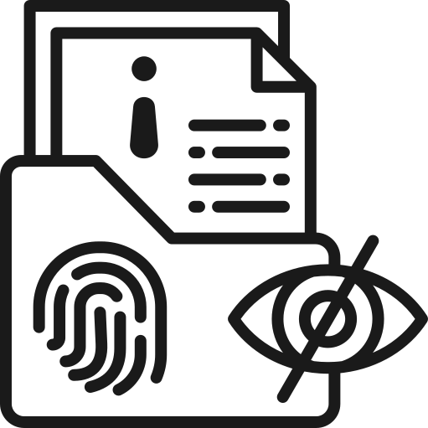
How to Recognize a Phishing
Email
Unexpected links
Generic greetings or unusual wording
The message asks you to click a link to log in, verify information, or make a payment.
For example: "Dear Customer" instead of your name.
Unexpected attachments
Suspicious sender address
The email contains a file
you were not expecting.
The sender's address may contain small
spelling changes or an unfamiliar domain.
Requests for sensitive information
The sender asks for your password, payment information, OTP, or other sensitive data.

Slide 6

How to Identify a Fake Website
Before entering sensitive information, check the website carefully.
01
Check the URL
  Look for misspelled domain names.
  Be careful with unusual domains or extra words.
  Make sure you are visiting the organization's legitimate domain.
02
Do not trust appearance alone
A phishing website can look almost identical to a real website.
03
Avoid unexpected login links
Instead of clicking a link in an email or message, type the official website address yourself or use a trusted bookmark.
04
Be careful with search advertisements
Attackers can use fake advertisements to direct users to phishing websites.
Never enter sensitive information if you are unsure
05
When in doubt, verify the website through an official channel.

Slide 7






Social Engineering Tactics
Is the use of psychological manipulation to convince people to reveal information or perform an action.
Urgency
"You must act within 10 minutes."
Fear
"Your account has been compromised."
Authority
The attacker pretends to be a manager, bank employee, government official, or IT administrator.
Curiosity
"You have received a confidential document."
Reward
"Congratulations! You have won a prize."
Trust
The attacker pretends to be someone the victim knows or a trusted organization.
Common tactics:

Slide 8
Real-World Example
FBI Warning: Fake IC3 Website
In September 2025, the FBI warned about threat actors impersonating the FBI's Internet Crime Complaint Center (IC3) website.
Attackers created spoofed websites that looked like the legitimate website. The fake domains could contain small spelling differences or use a different domain ending.
The goal was to trick users into providing personal and financial information.

Slide 9
  The website looked legitimate.
  The domain was slightly different.
  Users could reach the fake website while searching for the real service.
  Information entered into the fake website could be collected by attackers.
  Type the official website address directly into the browser.
  Carefully check the URL.
  Avoid suspicious search advertisements.
  Never enter sensitive information when the website's legitimacy is uncertain.
What made the attack dangerous?
How to stay safe

Slide 10


Best Practices to Avoid Phishing
Verify the sender and email address.
Check links before opening them.
Do not open unexpected attachments.
Do not provide passwords, OTPs, or financial information through unexpected requests.
Use Multi-Factor Authentication (MFA).
Keep your operating system, browser, and security software updated.
Think Before You Click
Use spam and phishing filters.
Contact organizations using official contact information — not information provided in a suspicious message.
Report suspicious messages to your organization or the appropriate reporting service.
When something feels urgent, slow down and verify first.

Slide 11

What Should You Do If You Clicked?
Stop interacting with the website.
Do not enter any additional information.
If you entered a password, change it immediately from the legitimate website.
Enable or review MFA on the affected account.
If you clicked a suspicious link:
If you downloaded a file, run a security scan.
Don't panic. Act quickly.
Report the incident to your organization's IT/security team.
If financial information was exposed, contact the financial institution through an official channel.
Report the phishing attempt through the appropriate reporting service.
The faster you respond, the more opportunities you have to reduce the impact.

Slide 12

Interactive Quiz:

Slide 13

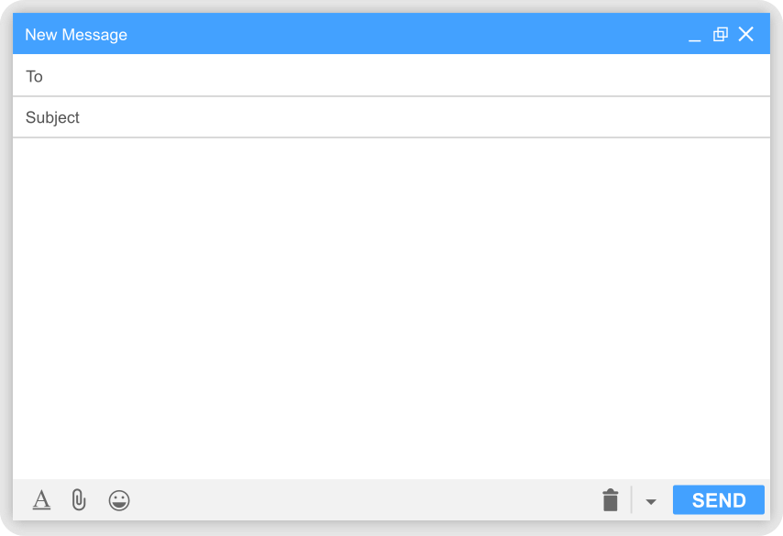

Quiz 1 :
Which signs suggest
this could be phishing?
From: support@paypa1-security.com
URGENT: Your account will be suspended!
Dear Customer,
We detected suspicious activity on your account.
Your account will be permanently suspended within 30 minutes.
Click the link below to verify your account immediately.
[Verify My Account]
A. Urgent language
B. Suspicious sender/domain
C. Request to click a login link
D. All of the above

Slide 14
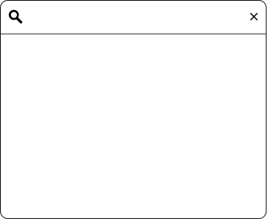
Quiz 2:
You search for your bank's website and see this result:
What should
you do?
www.mybank-secure-login.com
The page looks exactly like your bank's normal login page.
A. Enter your username and password.
B. Check the URL and access the bank through its official website or trusted bookmark.
C. Enter your password but not your OTP.
D. Continue because the website looks
professional.

Slide 15


Final Takeaways
STOP → CHECK → VERIFY → REPORT
  STOP
Don't react immediately to unexpected or urgent messages.
  CHECK
Look carefully at the sender, links, attachments, and wording.
  VERIFY
Use an official website or trusted contact method to confirm the request.
  REPORT
Report suspicious messages to your organization or the relevant authority.

Slide 16
References
Federal Trade Commission (FTC)
How To Recognize and Avoid Phishing Scams
FTC — How To Recognize and Avoid Phishing Scams
Federal Bureau of Investigation (FBI)
Spoofing and Phishing
FBI — Spoofing and Phishing
Federal Bureau of Investigation (FBI)
Threat Actors Spoofing the FBI IC3 Website — September 19, 2025
FBI — IC3 Spoofing Alert
Federal Bureau of Investigation (FBI)
Cybercriminals Impersonating Employee Self-Service Websites
FBI — Employee Self-Service Phishing Alert
Federal Trade Commission (FTC)
Protect Yourself From Phishing Scams
FTC — Protect Yourself From Phishing Scams

Slide 17
THANK
YOU

